Slide 1
PRINCIPAL FINANCIAL GROUP, INC.
01.15.2025 – 04.15.2025

Slide 2

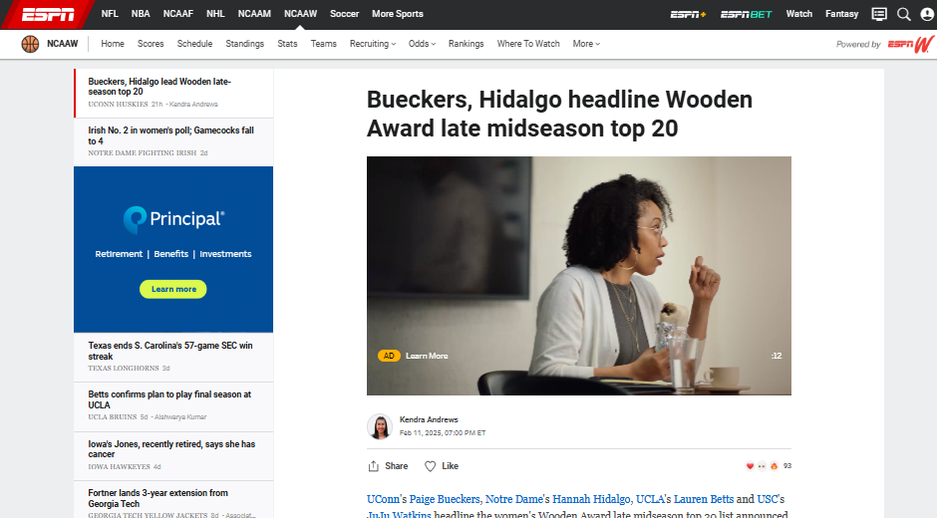

1150089-1_SPORTS | Digital | US | CBB | Women's Wooden Watch | Sponsorship| ESPN – Video Commercial – 30Sec - PC

Slide 3
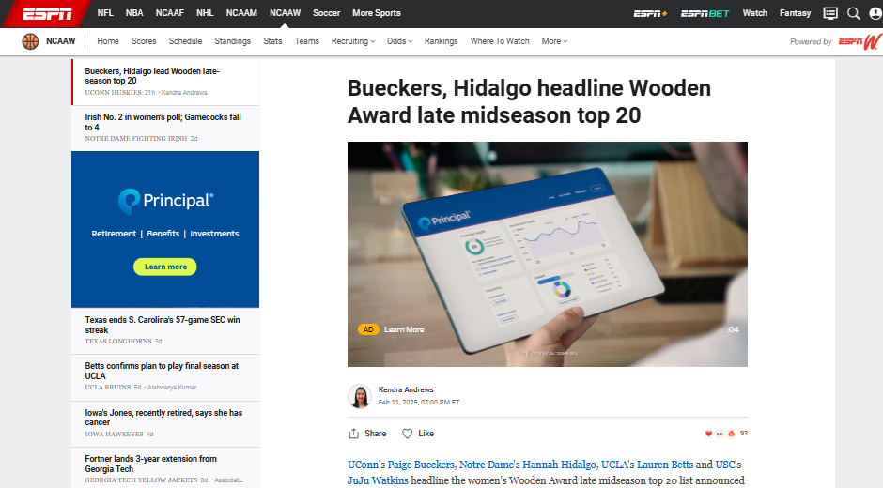
1150089-1_SPORTS | Digital | US | CBB | Women's Wooden Watch | Sponsorship| ESPN – Video Commercial – 30Sec - PC

Slide 4
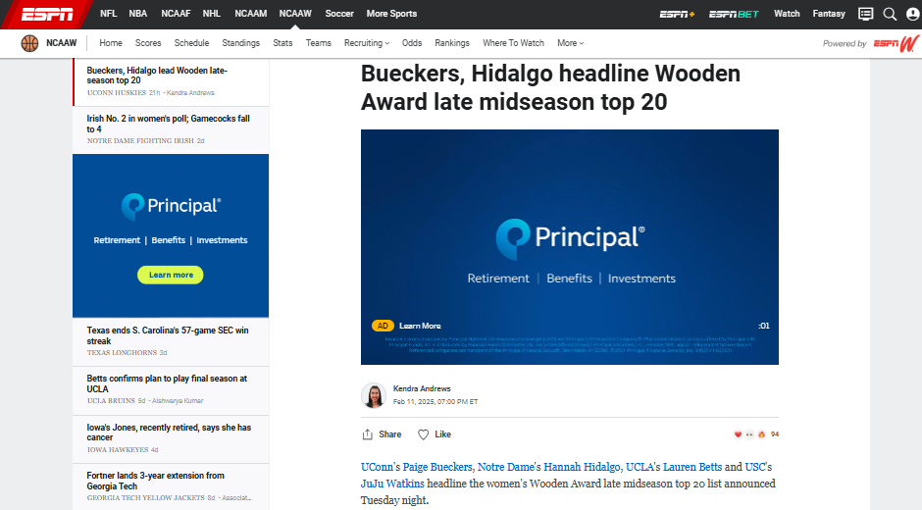
1150089-1_SPORTS | Digital | US | CBB | Women's Wooden Watch | Sponsorship| ESPN – Video Commercial – 30Sec - PC

Slide 5

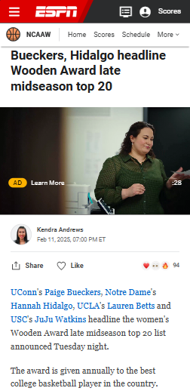

1150089-1_SPORTS | Digital | US | CBB | Women's Wooden Watch | Sponsorship| ESPN – Video Commercial – 30Sec - Mobile

Slide 6
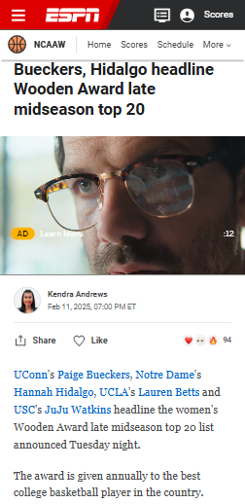
1150089-1_SPORTS | Digital | US | CBB | Women's Wooden Watch | Sponsorship| ESPN – Video Commercial – 30Sec - Mobile

Slide 7
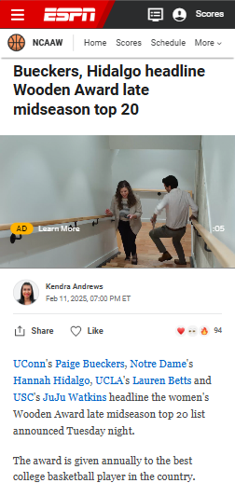
1150089-1_SPORTS | Digital | US | CBB | Women's Wooden Watch | Sponsorship| ESPN – Video Commercial – 30Sec - Mobile

Slide 8
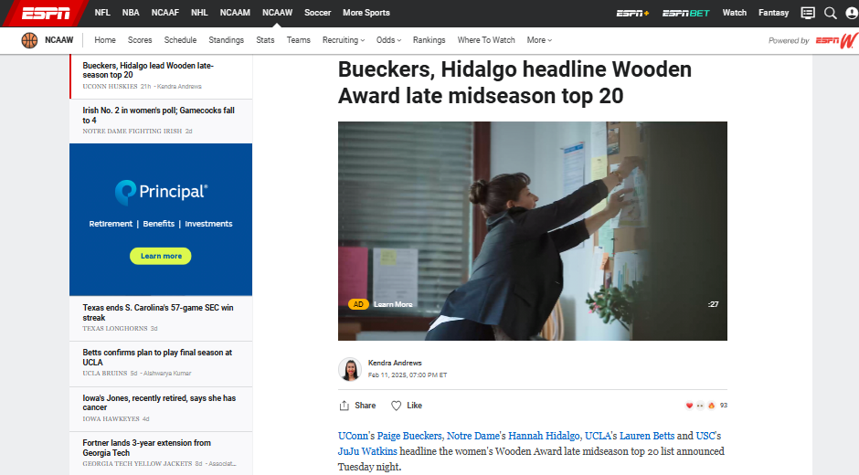
1150089-1_SPORTS | Digital | US | CBB | Women's Wooden Watch | Sponsorship| ESPN – Video Commercial – 30Sec - PC

Slide 9
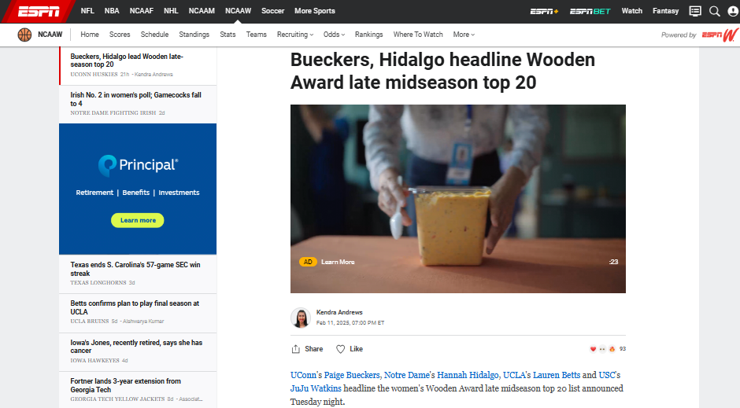
1150089-1_SPORTS | Digital | US | CBB | Women's Wooden Watch | Sponsorship| ESPN – Video Commercial – 30Sec - PC

Slide 10
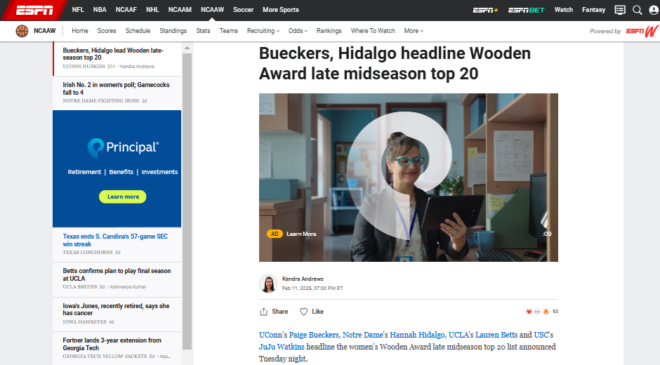
1150089-1_SPORTS | Digital | US | CBB | Women's Wooden Watch | Sponsorship| ESPN – Video Commercial – 30Sec - PC

Slide 11
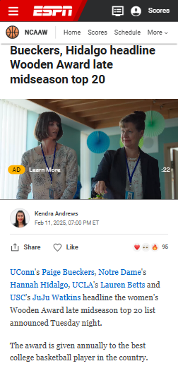
1150089-1_SPORTS | Digital | US | CBB | Women's Wooden Watch | Sponsorship| ESPN – Video Commercial – 30Sec - Mobile

Slide 12
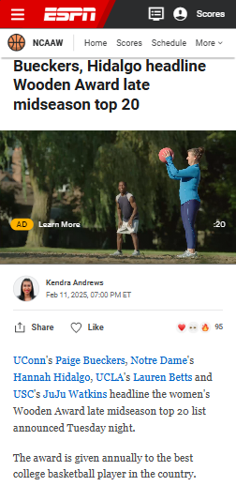
1150089-1_SPORTS | Digital | US | CBB | Women's Wooden Watch | Sponsorship| ESPN – Video Commercial – 30Sec - Mobile

Slide 13
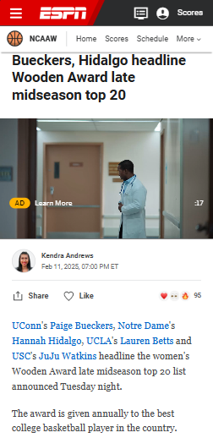
1150089-1_SPORTS | Digital | US | CBB | Women's Wooden Watch | Sponsorship| ESPN – Video Commercial – 30Sec - Mobile

Slide 14
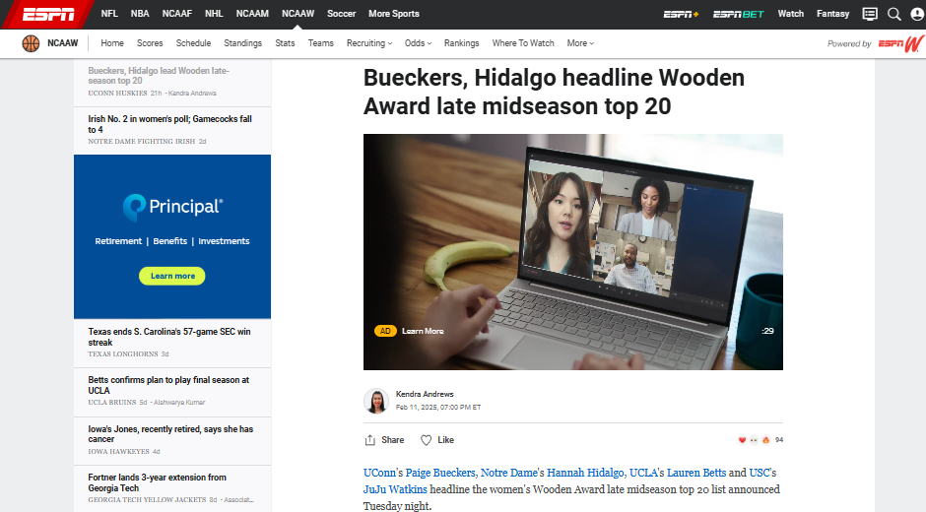
1150089-1_SPORTS | Digital | US | CBB | Women's Wooden Watch | Sponsorship| ESPN – Video Commercial – 30Sec - PC

Slide 15
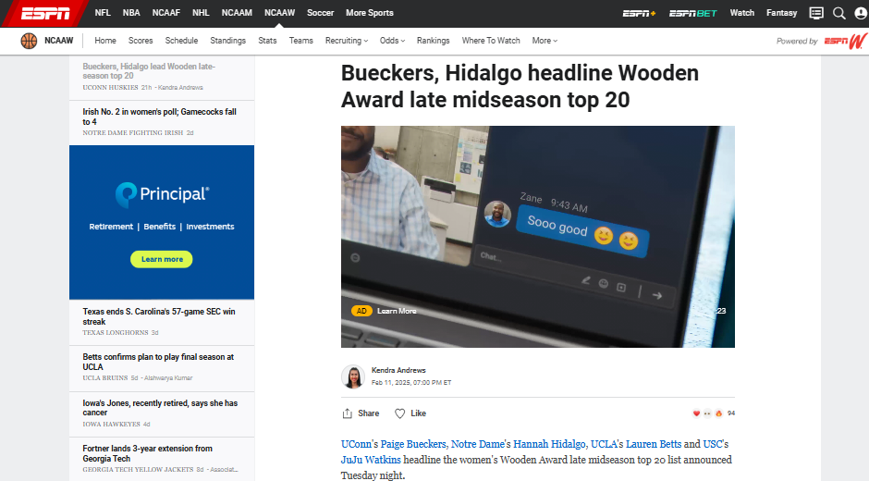
1150089-1_SPORTS | Digital | US | CBB | Women's Wooden Watch | Sponsorship| ESPN – Video Commercial – 30Sec - PC

Slide 16
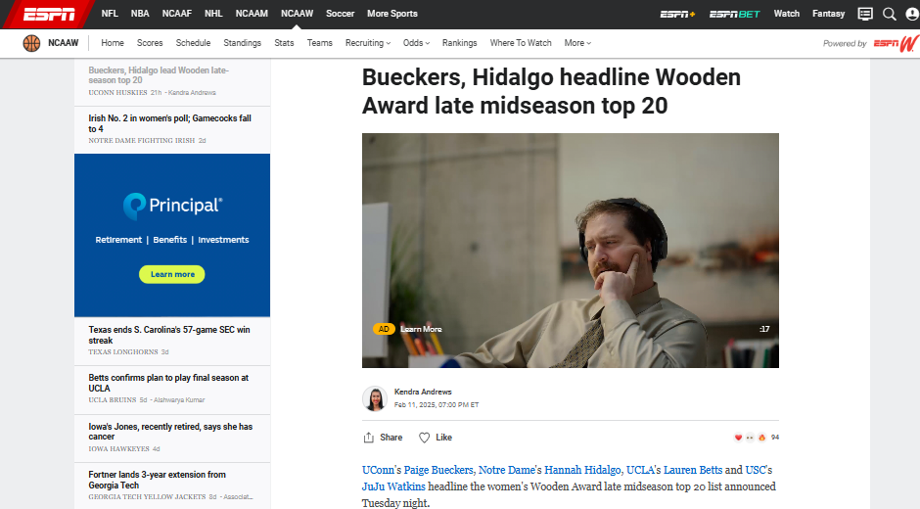
1150089-1_SPORTS | Digital | US | CBB | Women's Wooden Watch | Sponsorship| ESPN – Video Commercial – 30Sec - PC

Slide 17
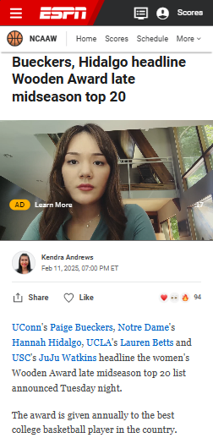
1150089-1_SPORTS | Digital | US | CBB | Women's Wooden Watch | Sponsorship| ESPN – Video Commercial – 30Sec - Mobile

Slide 18
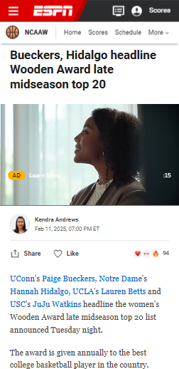
1150089-1_SPORTS | Digital | US | CBB | Women's Wooden Watch | Sponsorship| ESPN – Video Commercial – 30Sec - Mobile

Slide 19
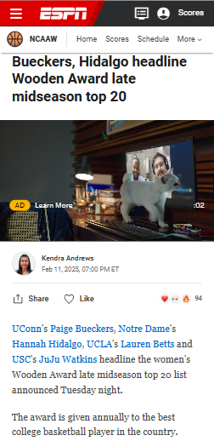
1150089-1_SPORTS | Digital | US | CBB | Women's Wooden Watch | Sponsorship| ESPN – Video Commercial – 30Sec - Mobile

Slide 20
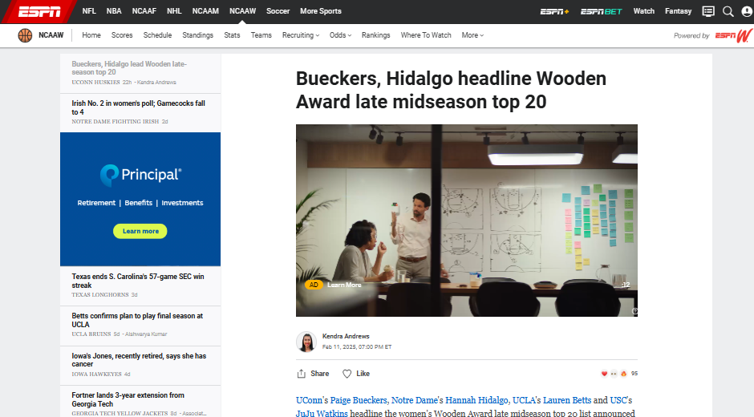
1150089-1_SPORTS | Digital | US | CBB | Women's Wooden Watch | Sponsorship| ESPN – Video Commercial – 15Sec - PC

Slide 21
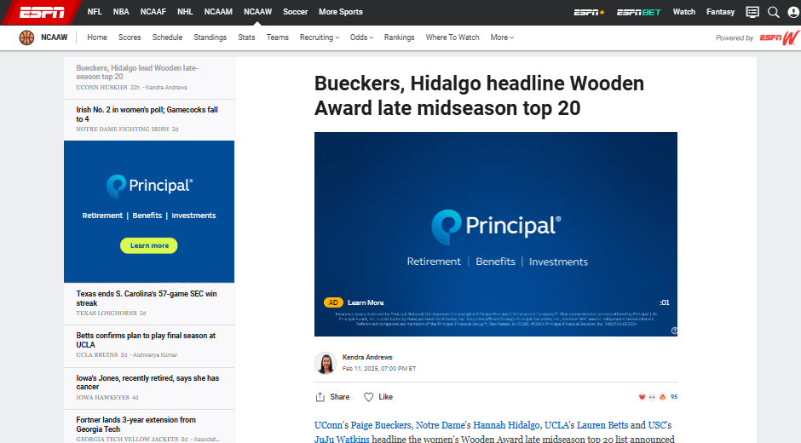
1150089-1_SPORTS | Digital | US | CBB | Women's Wooden Watch | Sponsorship| ESPN – Video Commercial – 15Sec - PC

Slide 22
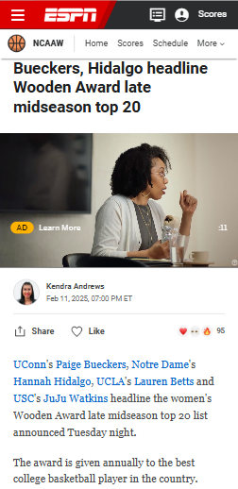
1150089-1_SPORTS | Digital | US | CBB | Women's Wooden Watch | Sponsorship| ESPN – Video Commercial – 15Sec - Mobile

Slide 23
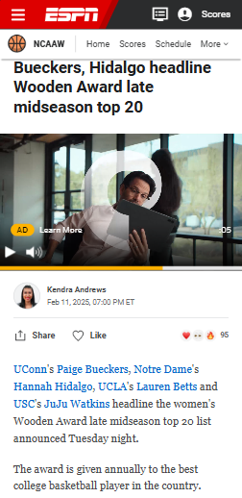
1150089-1_SPORTS | Digital | US | CBB | Women's Wooden Watch | Sponsorship| ESPN – Video Commercial – 15Sec - Mobile

Slide 24
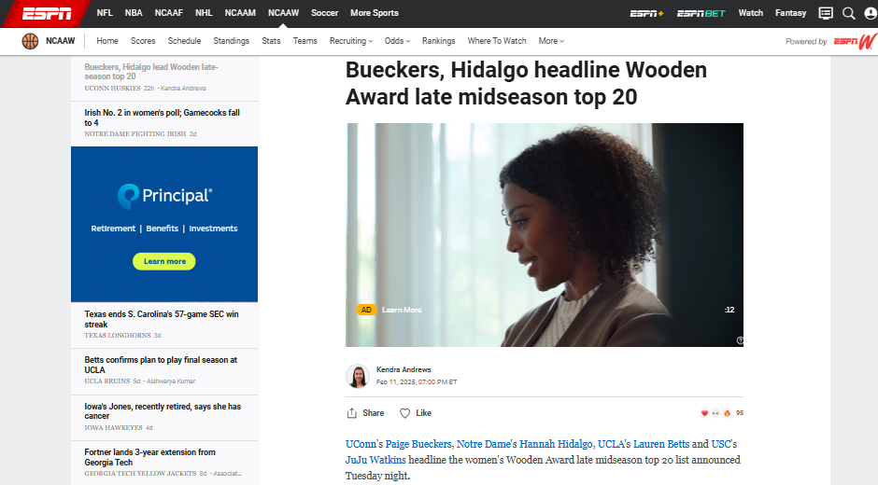
1150089-1_SPORTS | Digital | US | CBB | Women's Wooden Watch | Sponsorship| ESPN – Video Commercial – 15Sec - PC

Slide 25
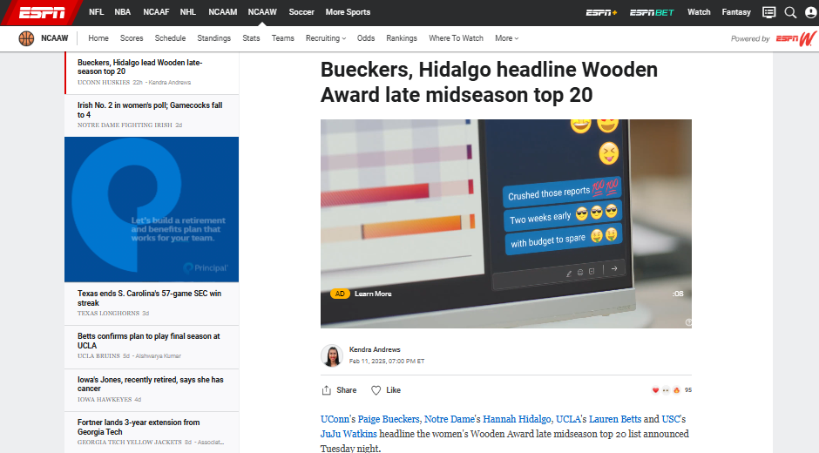
1150089-1_SPORTS | Digital | US | CBB | Women's Wooden Watch | Sponsorship| ESPN – Video Commercial – 15Sec - PC

Slide 26
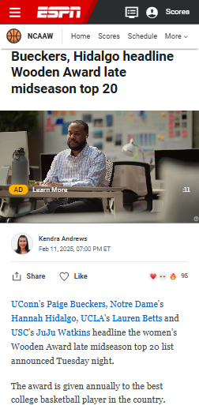
1150089-1_SPORTS | Digital | US | CBB | Women's Wooden Watch | Sponsorship| ESPN – Video Commercial – 15Sec - Mobile

Slide 27

1150089-1_SPORTS | Digital | US | CBB | Women's Wooden Watch | Sponsorship| ESPN – Video Commercial – 15Sec - Mobile

Slide 28
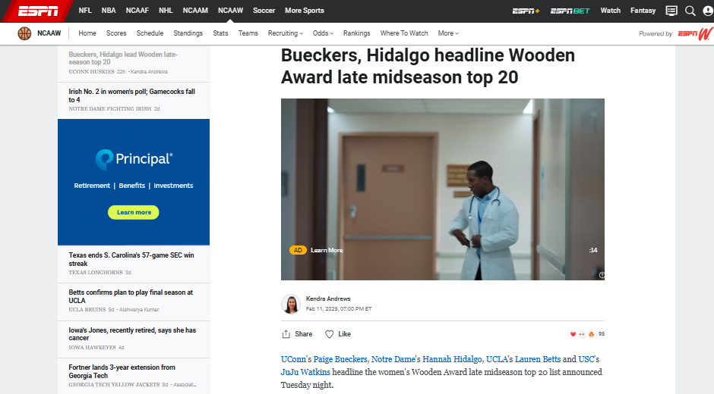
1150089-1_SPORTS | Digital | US | CBB | Women's Wooden Watch | Sponsorship| ESPN – Video Commercial – 15Sec - PC

Slide 29
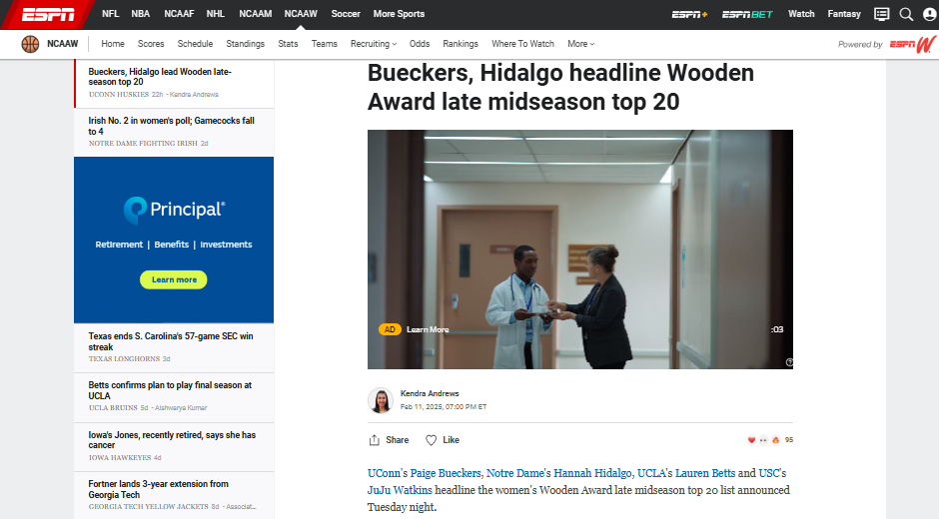
1150089-1_SPORTS | Digital | US | CBB | Women's Wooden Watch | Sponsorship| ESPN – Video Commercial – 15Sec - PC

Slide 30
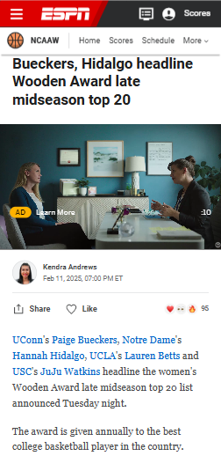
1150089-1_SPORTS | Digital | US | CBB | Women's Wooden Watch | Sponsorship| ESPN – Video Commercial – 15Sec - Mobile

Slide 31
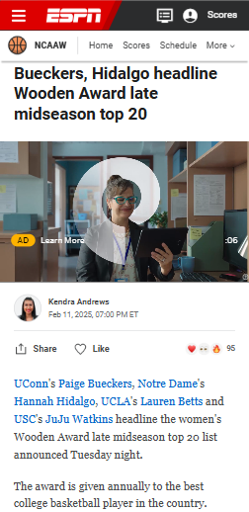
1150089-1_SPORTS | Digital | US | CBB | Women's Wooden Watch | Sponsorship| ESPN – Video Commercial – 15Sec - Mobile

Slide 32
PRINCIPAL FINANCIAL GROUP, INC.
01.15.2025 – 03.15.2025

Slide 33
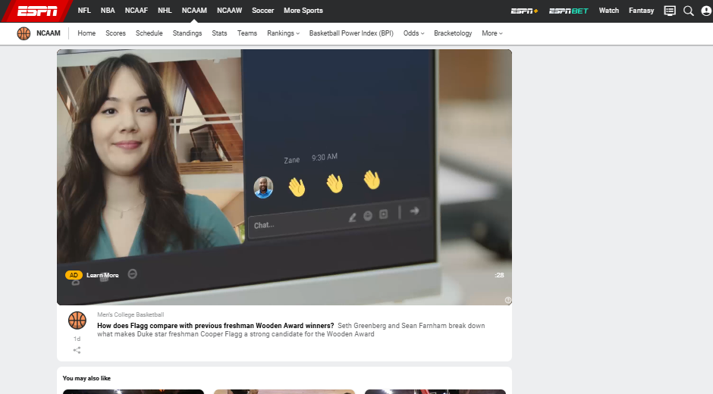
1140619-1_SPORTS | Digital | US | CBB | Wooden Watch Video | Sponsorship | Men| ESPN – Video Commercial – 30Sec - PC

Slide 34
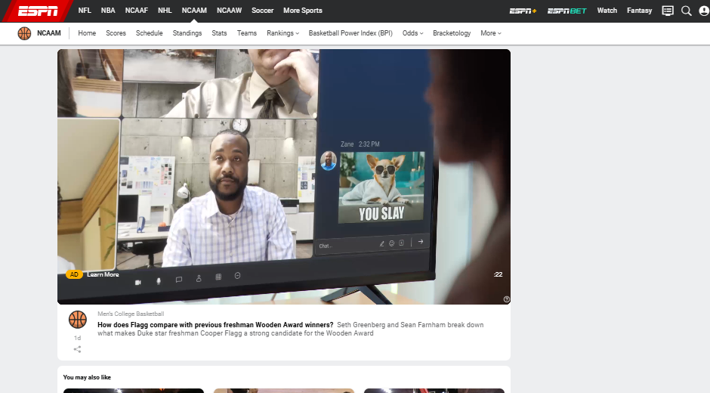
1140619-1_SPORTS | Digital | US | CBB | Wooden Watch Video | Sponsorship | Men| ESPN – Video Commercial – 30Sec - PC

Slide 35
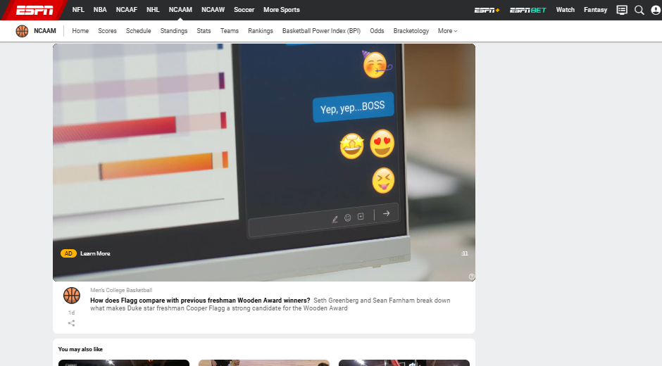
1140619-1_SPORTS | Digital | US | CBB | Wooden Watch Video | Sponsorship | Men| ESPN – Video Commercial – 30Sec - PC

Slide 36
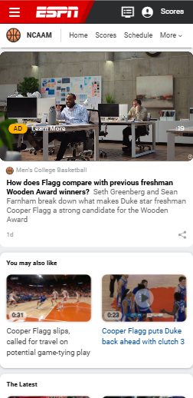
1140619-1_SPORTS | Digital | US | CBB | Wooden Watch Video | Sponsorship | Men| ESPN – Video Commercial – 30Sec - Mobile

Slide 37
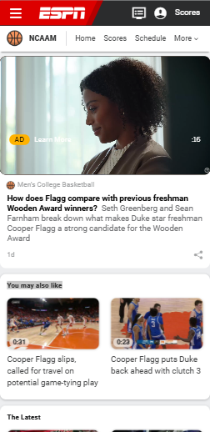
1140619-1_SPORTS | Digital | US | CBB | Wooden Watch Video | Sponsorship | Men| ESPN – Video Commercial – 30Sec - Mobile

Slide 38
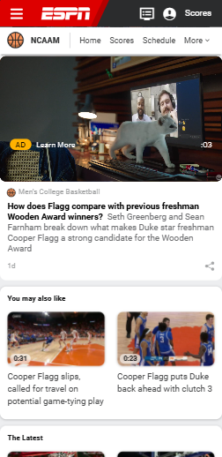
1140619-1_SPORTS | Digital | US | CBB | Wooden Watch Video | Sponsorship | Men| ESPN – Video Commercial – 30Sec - Mobile

Slide 39
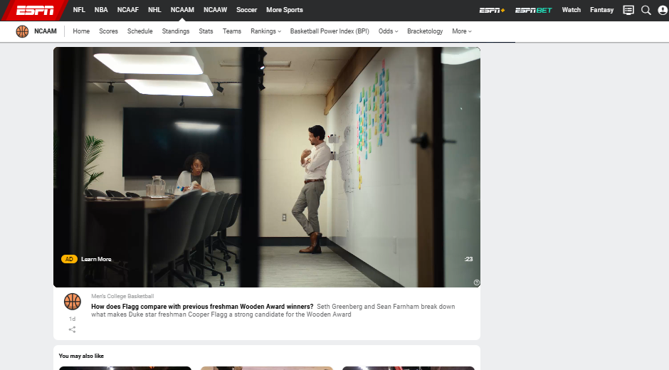
1140619-1_SPORTS | Digital | US | CBB | Wooden Watch Video | Sponsorship | Men| ESPN – Video Commercial – 30Sec - PC

Slide 40
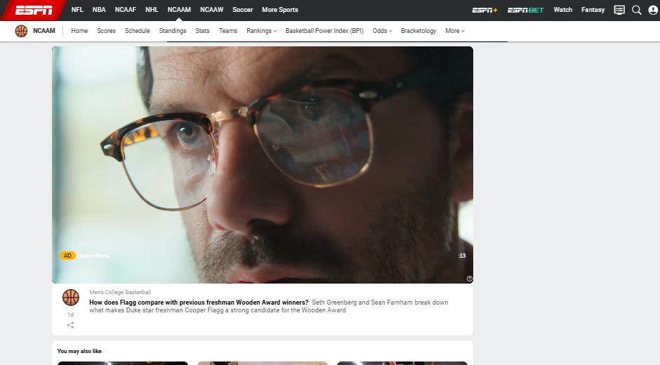
1140619-1_SPORTS | Digital | US | CBB | Wooden Watch Video | Sponsorship | Men| ESPN – Video Commercial – 30Sec - PC

Slide 41
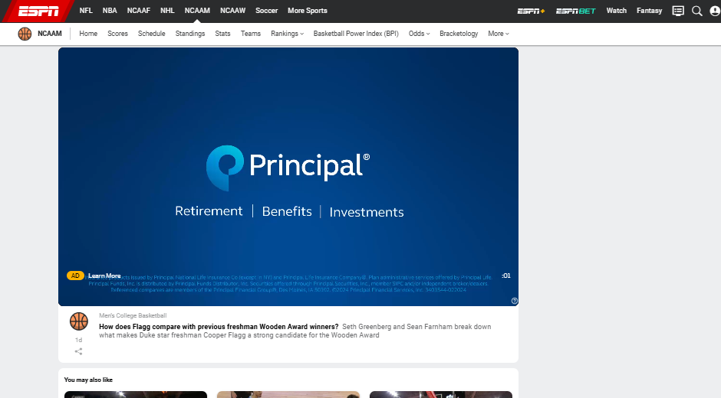
1140619-1_SPORTS | Digital | US | CBB | Wooden Watch Video | Sponsorship | Men| ESPN – Video Commercial – 30Sec - PC

Slide 42
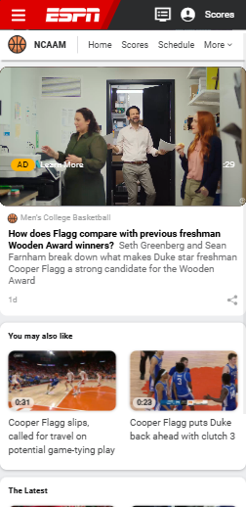
1140619-1_SPORTS | Digital | US | CBB | Wooden Watch Video | Sponsorship | Men| ESPN – Video Commercial – 30Sec - Mobile

Slide 43
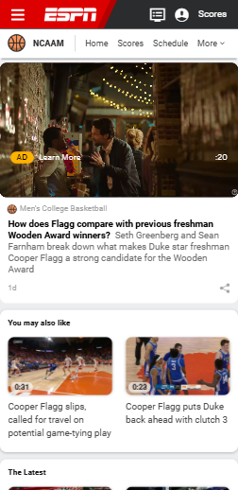
1140619-1_SPORTS | Digital | US | CBB | Wooden Watch Video | Sponsorship | Men| ESPN – Video Commercial – 30Sec - Mobile

Slide 44
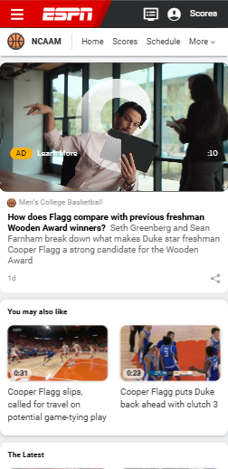
1140619-1_SPORTS | Digital | US | CBB | Wooden Watch Video | Sponsorship | Men| ESPN – Video Commercial – 30Sec - Mobile

Slide 45
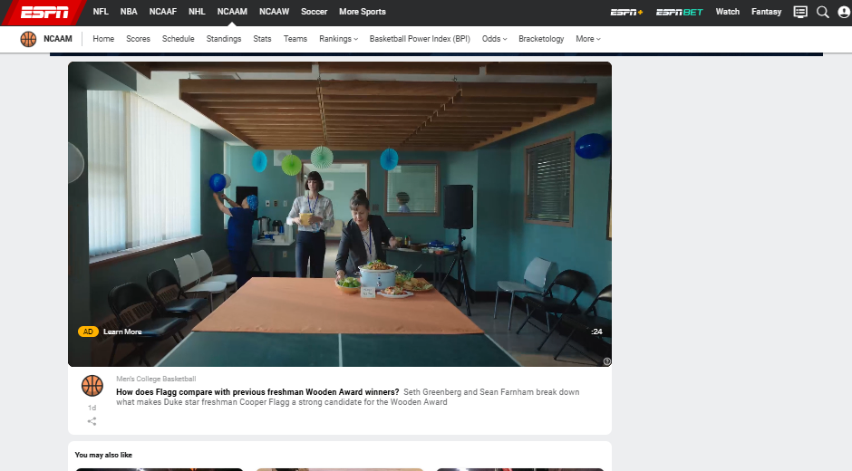
1140619-1_SPORTS | Digital | US | CBB | Wooden Watch Video | Sponsorship | Men| ESPN – Video Commercial – 30Sec - PC

Slide 46
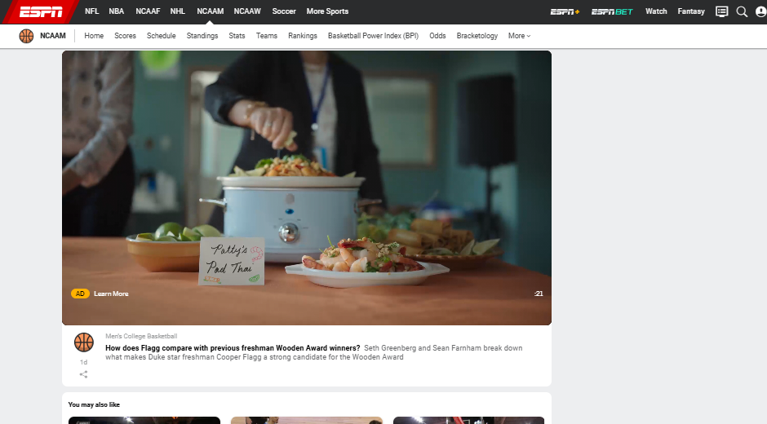
1140619-1_SPORTS | Digital | US | CBB | Wooden Watch Video | Sponsorship | Men| ESPN – Video Commercial – 30Sec - PC

Slide 47
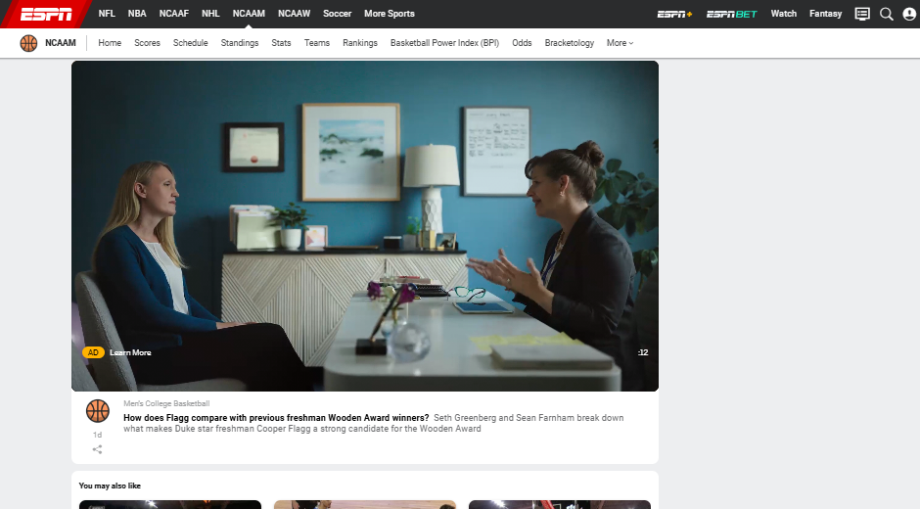
1140619-1_SPORTS | Digital | US | CBB | Wooden Watch Video | Sponsorship | Men| ESPN – Video Commercial – 30Sec - PC

Slide 48
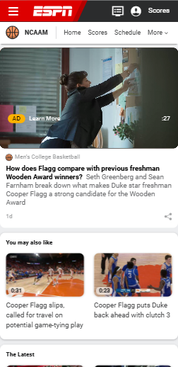
1140619-1_SPORTS | Digital | US | CBB | Wooden Watch Video | Sponsorship | Men| ESPN – Video Commercial – 30Sec - Mobile

Slide 49
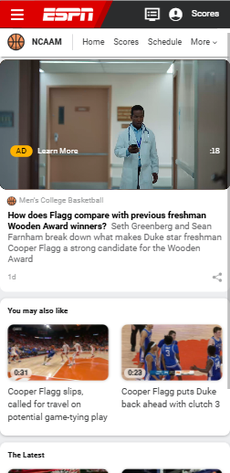
1140619-1_SPORTS | Digital | US | CBB | Wooden Watch Video | Sponsorship | Men| ESPN – Video Commercial – 30Sec - Mobile

Slide 50
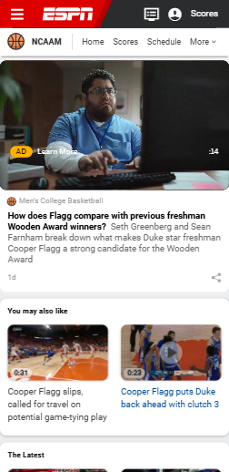
1140619-1_SPORTS | Digital | US | CBB | Wooden Watch Video | Sponsorship | Men| ESPN – Video Commercial – 30Sec - Mobile

Slide 51
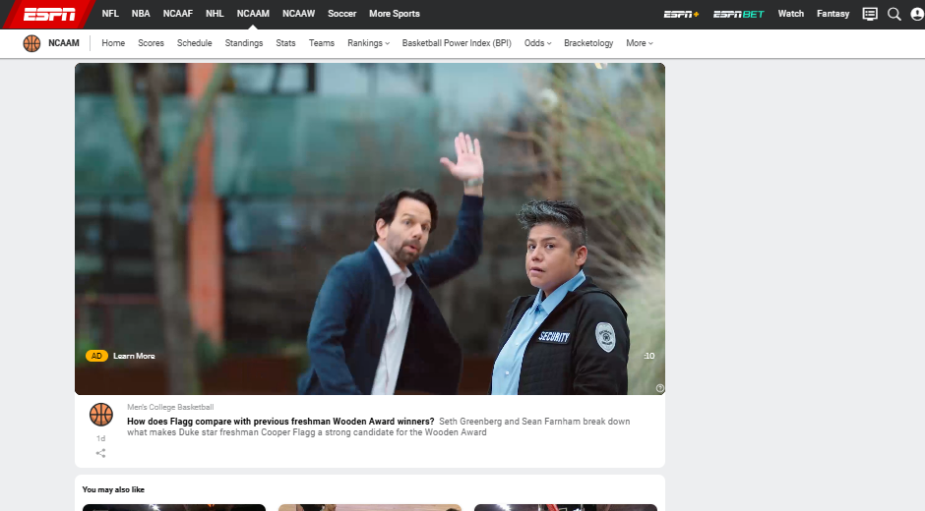
1140619-1_SPORTS | Digital | US | CBB | Wooden Watch Video | Sponsorship | Men| ESPN – Video Commercial – 15Sec - PC

Slide 52
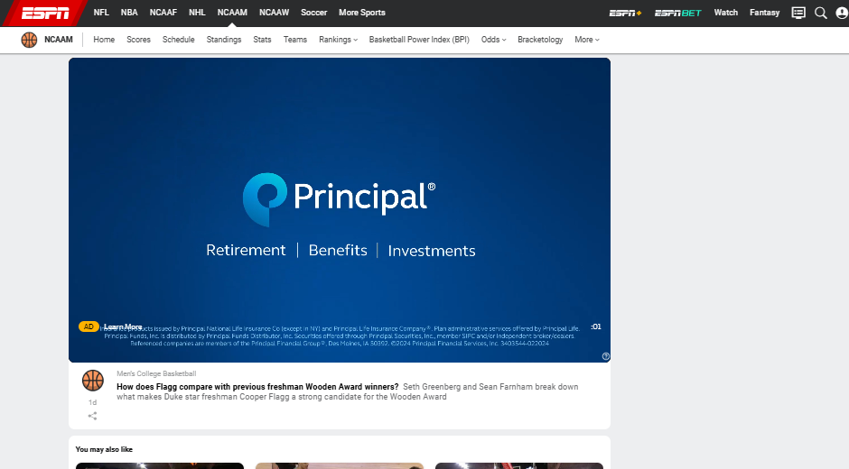
1140619-1_SPORTS | Digital | US | CBB | Wooden Watch Video | Sponsorship | Men| ESPN – Video Commercial – 15Sec - PC

Slide 53
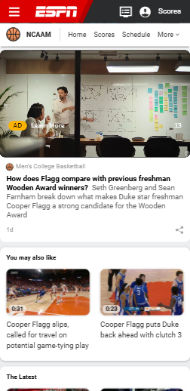
1140619-1_SPORTS | Digital | US | CBB | Wooden Watch Video | Sponsorship | Men| ESPN – Video Commercial – 15Sec - Mobile

Slide 54

1140619-1_SPORTS | Digital | US | CBB | Wooden Watch Video | Sponsorship | Men| ESPN – Video Commercial – 15Sec - Mobile

Slide 55

1140619-1_SPORTS | Digital | US | CBB | Wooden Watch Video | Sponsorship | Men| ESPN – Video Commercial – 15Sec - PC

Slide 56

1140619-1_SPORTS | Digital | US | CBB | Wooden Watch Video | Sponsorship | Men| ESPN – Video Commercial – 15Sec - PC

Slide 57

1140619-1_SPORTS | Digital | US | CBB | Wooden Watch Video | Sponsorship | Men| ESPN – Video Commercial – 15Sec - Mobile

Slide 58

1140619-1_SPORTS | Digital | US | CBB | Wooden Watch Video | Sponsorship | Men| ESPN – Video Commercial – 15Sec - Mobile

Slide 59

1140619-1_SPORTS | Digital | US | CBB | Wooden Watch Video | Sponsorship | Men| ESPN – Video Commercial – 15Sec - PC

Slide 60

1140619-1_SPORTS | Digital | US | CBB | Wooden Watch Video | Sponsorship | Men| ESPN – Video Commercial – 15Sec - PC

Slide 61

1140619-1_SPORTS | Digital | US | CBB | Wooden Watch Video | Sponsorship | Men| ESPN – Video Commercial – 15Sec - Mobile

Slide 62
1140619-1_SPORTS | Digital | US | CBB | Wooden Watch Video | Sponsorship | Men| ESPN – Video Commercial – 15Sec - Mobile

Slide 63
PRINCIPAL FINANCIAL GROUP, INC.
01.15.2025 – 03.15.2025

Slide 64

1150073-1_SPORTS | Digital | US | WCBB | Story Display | Sponsorship| ESPN – Display – 1280x100 & 300x250 – PC

Slide 65

1150073-1_SPORTS | Digital | US | WCBB | Story Display | Sponsorship| ESPN – Display – 1280x100 & 300x250 – PC

Slide 66



1150073-1_SPORTS | Digital | US | WCBB | Story Display | Sponsorship| ESPN – Display – 970x66 & 300x250 - I PAD PRO

Slide 67

1150073-1_SPORTS | Digital | US | WCBB | Story Display | Sponsorship| ESPN – Display – 970x66 & 300x250 - I PAD PRO

Slide 68

1150073-1_SPORTS | Digital | US | WCBB | Story Display | Sponsorship| ESPN – Display – 728x90 - I PAD

Slide 69

1150073-1_SPORTS | Digital | US | WCBB | Story Display | Sponsorship| ESPN – Display – 728x90 - I PAD

Slide 70

1150073-1_SPORTS | Digital | US | WCBB | Story Display | Sponsorship| ESPN – Display – 300X250 - Mobile

Slide 71

1150073-1_SPORTS | Digital | US | WCBB | Story Display | Sponsorship| ESPN – Display – 300X250 - Mobile

Slide 72

1150073-1_SPORTS | Digital | US | WCBB | Story Display | Sponsorship| ESPN – Display – 320X50 - Mobile

Slide 73
PRINCIPAL FINANCIAL GROUP, INC.
01.15.2025 – 03.15.2025

Slide 74

1150072-1_SPORTS | Digital | US | CBB | Story Display | Sponsorship| ESPN – Display – 1280x100 & 300x250 – PC

Slide 75

1150072-1_SPORTS | Digital | US | CBB | Story Display | Sponsorship| ESPN – Display – 1280x100 & 300x250 – PC

Slide 76

1150072-1_SPORTS | Digital | US | CBB | Story Display | Sponsorship| ESPN – Display – 970x66 & 300x250 - I PAD PRO

Slide 77

1150072-1_SPORTS | Digital | US | CBB | Story Display | Sponsorship| ESPN – Display – 970x66 & 300x250 - I PAD PRO

Slide 78

1150072-1_SPORTS | Digital | US | CBB | Story Display | Sponsorship| ESPN – Display – 728x90 - I PAD

Slide 79

1150072-1_SPORTS | Digital | US | CBB | Story Display | Sponsorship| ESPN – Display – 728x90 - I PAD

Slide 80

1150072-1_SPORTS | Digital | US | CBB | Story Display | Sponsorship| ESPN – Display – 728x90 - I PAD

Slide 81

1150072-1_SPORTS | Digital | US | CBB | Story Display | Sponsorship| ESPN – Display – 300X250 - Mobile

Slide 82

1150072-1_SPORTS | Digital | US | CBB | Story Display | Sponsorship| ESPN – Display – 300X250 - Mobile

Slide 83

1150072-1_SPORTS | Digital | US | CBB | Story Display | Sponsorship| ESPN – Display – 320X50 - Mobile

Slide 84

1150072-1_SPORTS | Digital | US | CBB | Story Display | Sponsorship| ESPN – Display – 320X50 - Mobile

