Slide 1
PRINCIPAL FINANCIAL GROUP, INC.
01.30.2025 – 03.15.2025

Slide 2
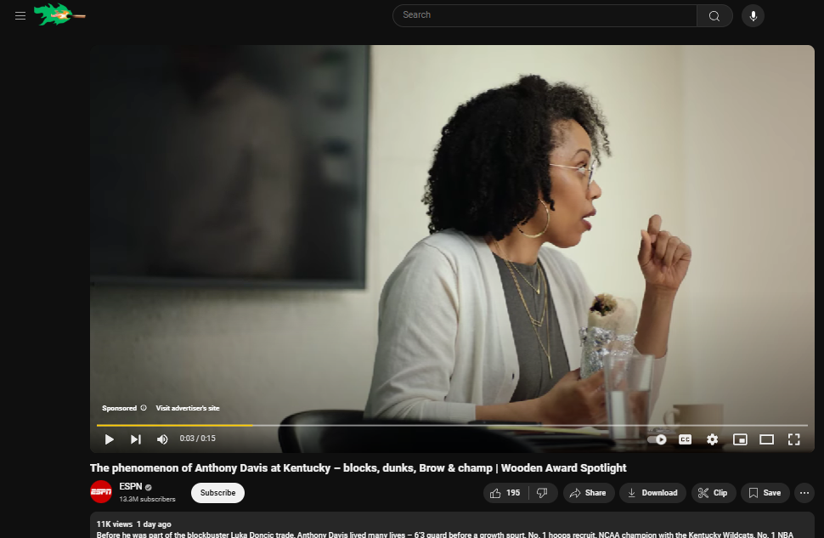


1162126-1_SPORTS | Digital | US | YouTube | WoodenAwardsSpotlight | Video | Sponsorship| YOUTUBE – Video Commercial – 15Sec - PC

Slide 3
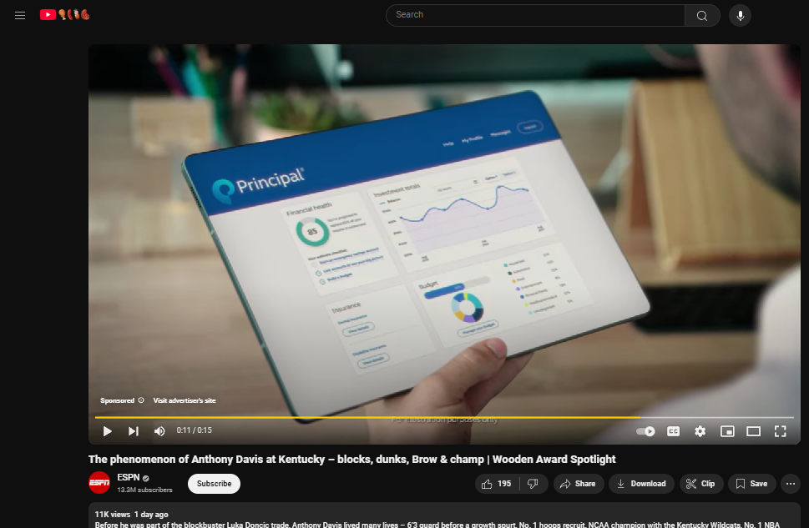
1162126-1_SPORTS | Digital | US | YouTube | WoodenAwardsSpotlight | Video | Sponsorship| YOUTUBE – Video Commercial – 15Sec - PC

Slide 4
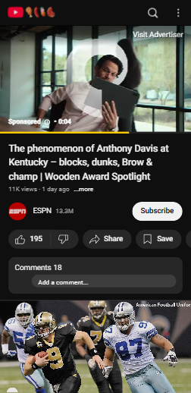


1162126-1_SPORTS | Digital | US | YouTube | WoodenAwardsSpotlight | Video | Sponsorship| YOUTUBE – Video Commercial – 15Sec - Mobile

Slide 5
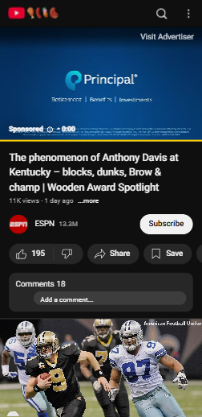
1162126-1_SPORTS | Digital | US | YouTube | WoodenAwardsSpotlight | Video | Sponsorship| YOUTUBE – Video Commercial – 15Sec - Mobile

